Slide 1


The Boston
Compact

Slide 2
If you want to be an optimist about America, stand on your head.
The country looks so much better from the bottom up.
Thomas Friedman

Slide 3
Some communities are forming what I call “complex adaptive coalitions” and are thriving from the bottom up.
And others that can’t build such adaptive coalitions are rapidly deteriorating.
Thomas Friedman

Slide 4

Our Mission:
Help leaders build
smarter & stronger
communities

Slide 5
The Problem
Businesses have data analytics
Communities don’t (with consistency)
It’s a massive problem

Slide 6
The Boston Compact Opportunity
The Boston Compact seeks to create positive impact within the city
CDP can provide expert data analytics to ensure efficacy

Slide 7



NDP was a prototype launched with the support of Wendy and Eric Schmidt (Google). The goal was to:
Build a global data analytics team
Answer “Pressing Questions” for the community
Share leading visualizations to tell reliable, compelling stories
Leverage the successful Nantucket prototype to help other communities

Slide 8
The community’s first “Pressing Question” was to determine the island’s unknown permanent and daily populations.
In July 2018 our data analytics team successfully presented a breakthrough report to the community.

Slide 9
Nantucket’s
Effective Population
After decades of debate, NDP provided a high confidence estimate of the community’s daily population

Slide 10


Slide 11
A Saturday in July
NDP aggregated and presented a wide variety of relevant data including mobility data, transportation data, and airline & ferry schedules to understand the community’s population

Slide 12
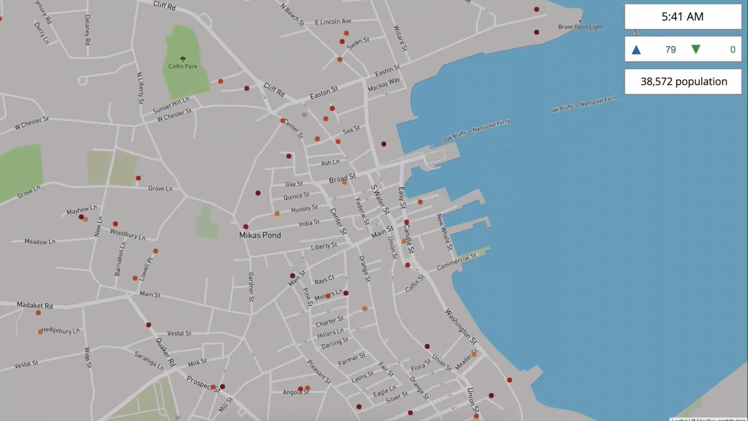

Slide 13

Massive Community Support

Slide 14
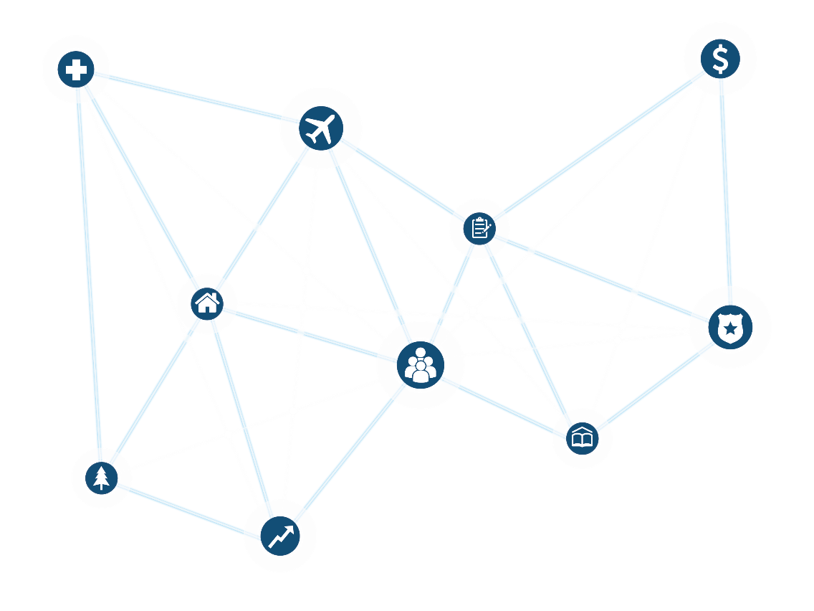
CDP’s Data Analytics Are Having Wide Impact on Interconnected Policy Areas
Municipal Finance
Healthcare
Tourism
Qualitative Survey Panel
Affordable Housing
Law Enforcement
Population
Education
Coastal Resilience
Business

Slide 15
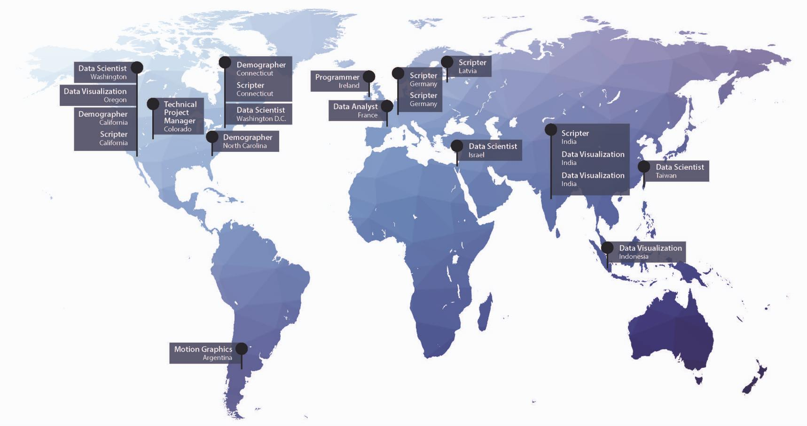
CDP’s Skilled Data Team

Slide 16
A Effective Process to Support
Community Understanding
Identify a Pressing Question
Develop a Methodology
Aggregate Data
Develop Insights
Create Compelling Visualizations
Persist

Slide 17
CDP has the analytics team and proven approaches to help the Boston Compact:
Identify potential areas of impact
Develop reliable descriptive & predictive analytics and compelling visualizations to bring key issues to life
Provide continuous analytics support to measure and improve outcomes
“Supporting the Boston Compact’s effort to make Boston smarter and stronger.”

