Slide 1
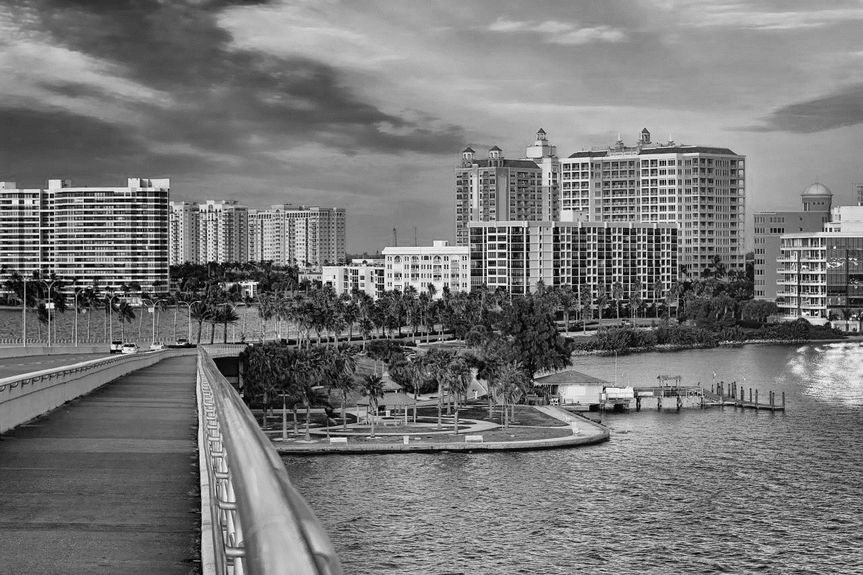


Slide 2
Help leaders build
smarter & stronger
communities

Slide 3
The Problem
Businesses have data analytics
Communities don’t
It’s a massive problem

Slide 4
80% of businesses have analytics
      Decision making quality & speed
      Planning & forecasting
80% of executives believe the ‘have nots’ will be going out of business

Slide 5
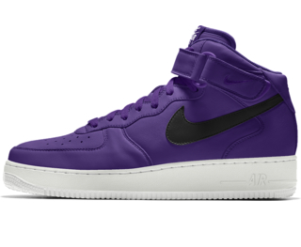

It’s Not OK that Nike has Analytics
But Communities we Love Don’t

Slide 6



Three Risks
Wasted Money
Wasted Time
Damaged Reputations

Slide 7
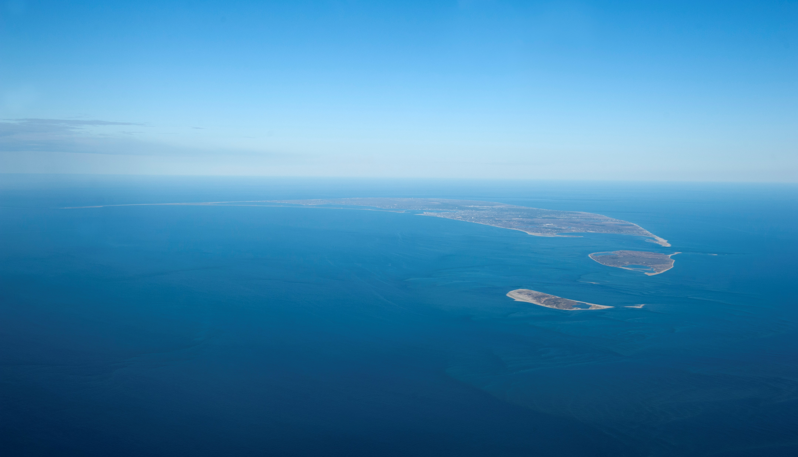


Slide 8
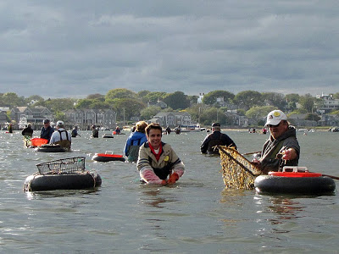
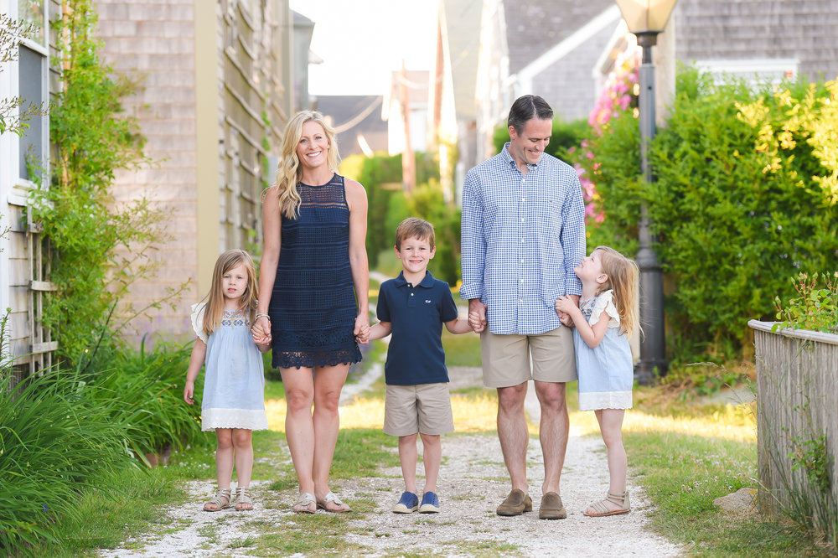
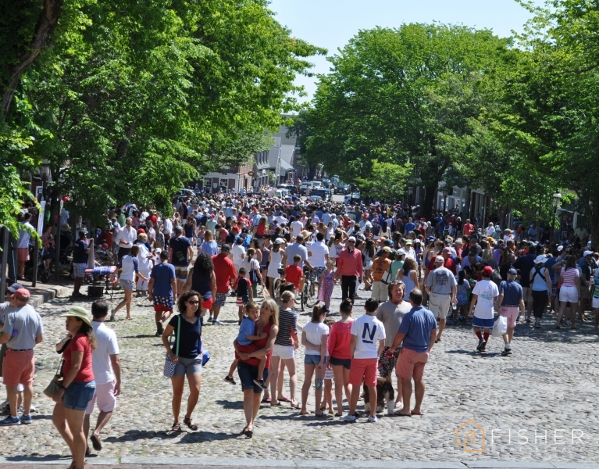
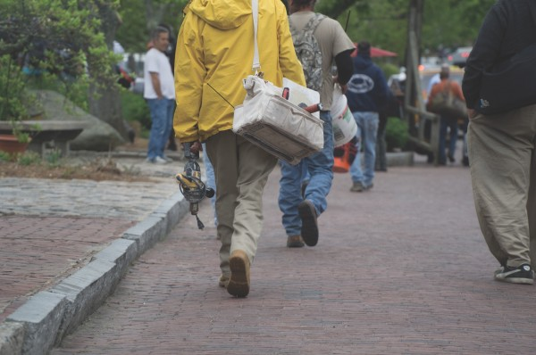

Understanding Functional Population
Permanent Residents
Seasonal Residents
Visitors
Commuters
Seasonal Workers

Slide 9
Nantucket’s 2017 Functional Population

Slide 10


Slide 11
Minute By Minute
Population Change

Slide 12
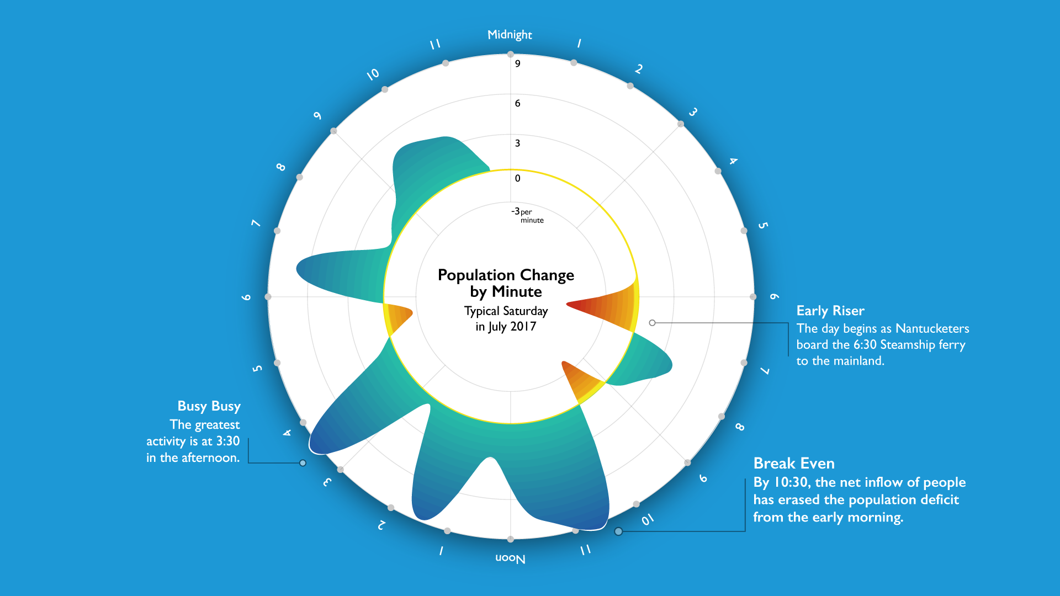

Slide 13
A Saturday in July

Slide 14

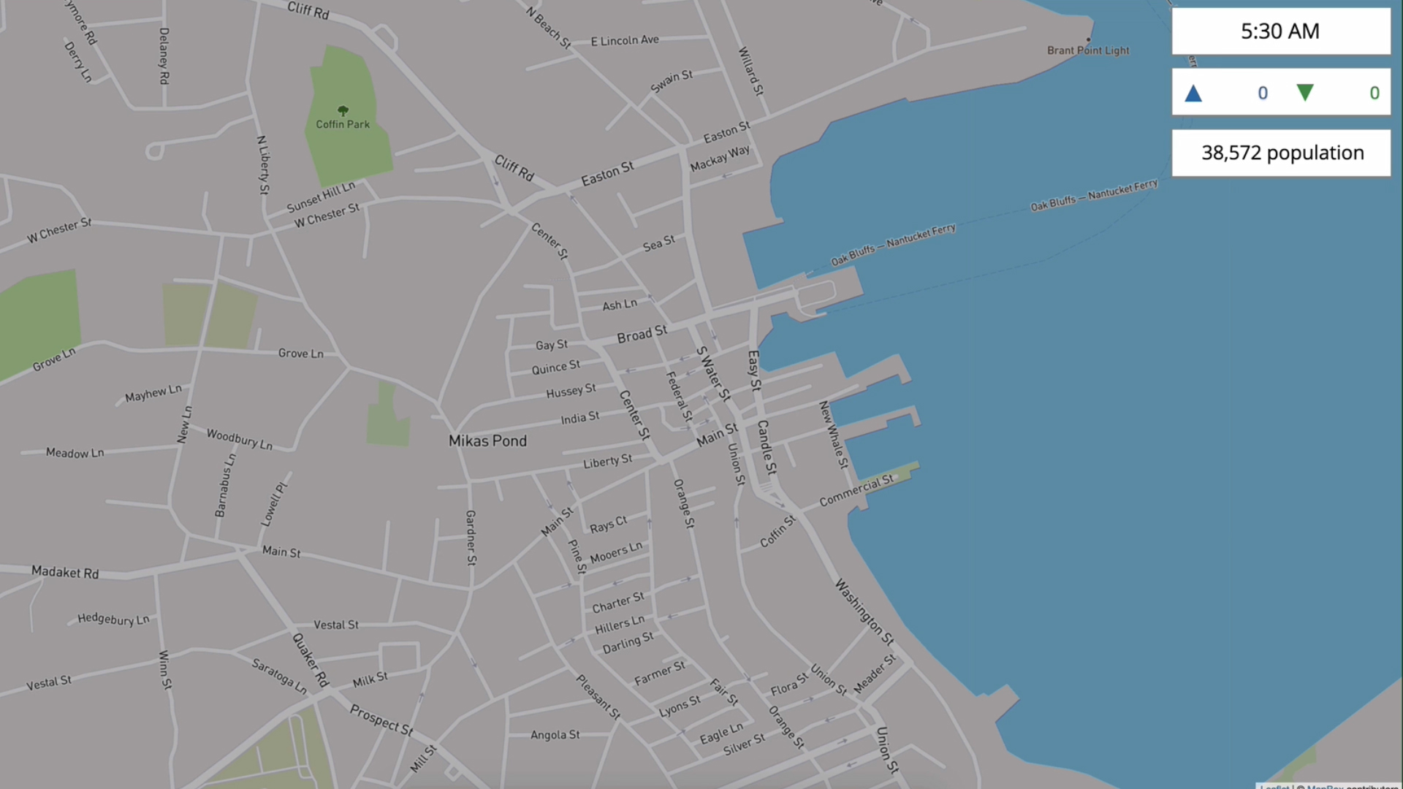

Slide 15
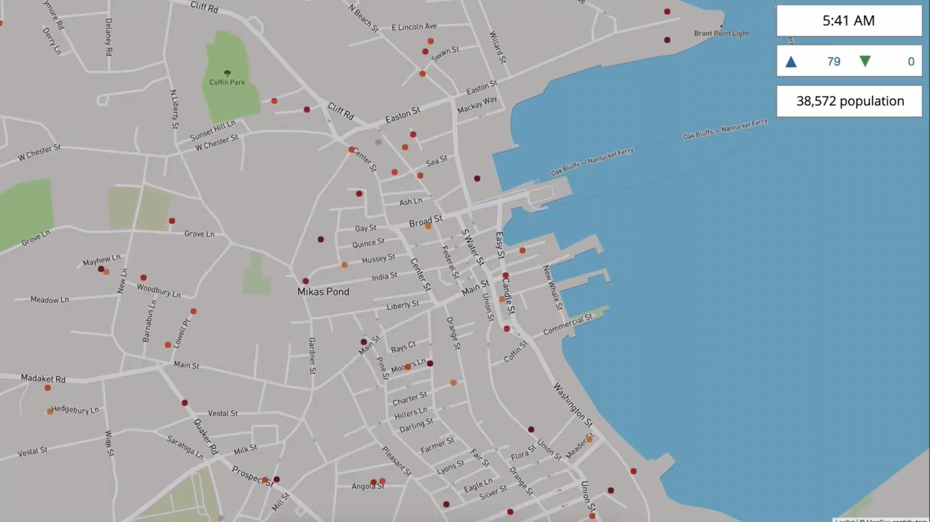

Slide 16
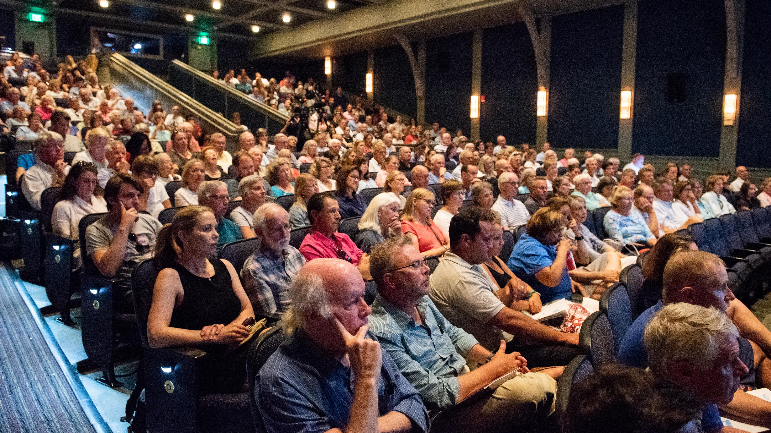

Slide 17

A Known Unknown
Permanent Population
11k
US Census
15k – 25k
Local Estimates
17k
NDP
Too Small
Just Right
Seasonal Population
Too Big
NA
US Census
70k – 80k
Local Estimates
49k
NDP

Slide 18
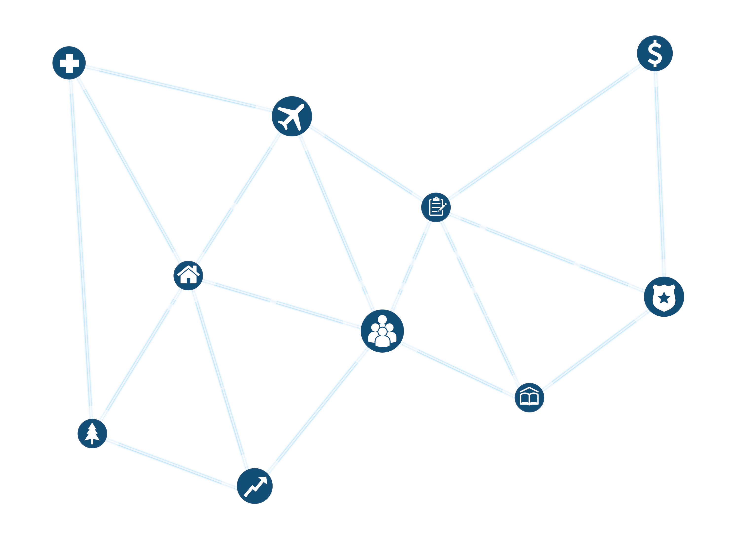
Wide Impact

Slide 19
The Impact: Small Business
Small Business

Slide 20
The Impact: Economic Development
Economic Development

Slide 21
The Impact: Healthcare
Healthcare

Slide 22
The Impact: Coastal Resilience
Coastal Resilience

Slide 23
“We love to fund disruptive and new ways of doing things, and this is revolutionary.”
Wendy Schmidt
President, Schmidt Family Foundation

Slide 24
Answering More Pressing Questions
Population
Tourism
2020 Census
Healthcare
Housing
Government Finance
Traffic
Education
Mental Health
Qualitative Survey Panel

Slide 26
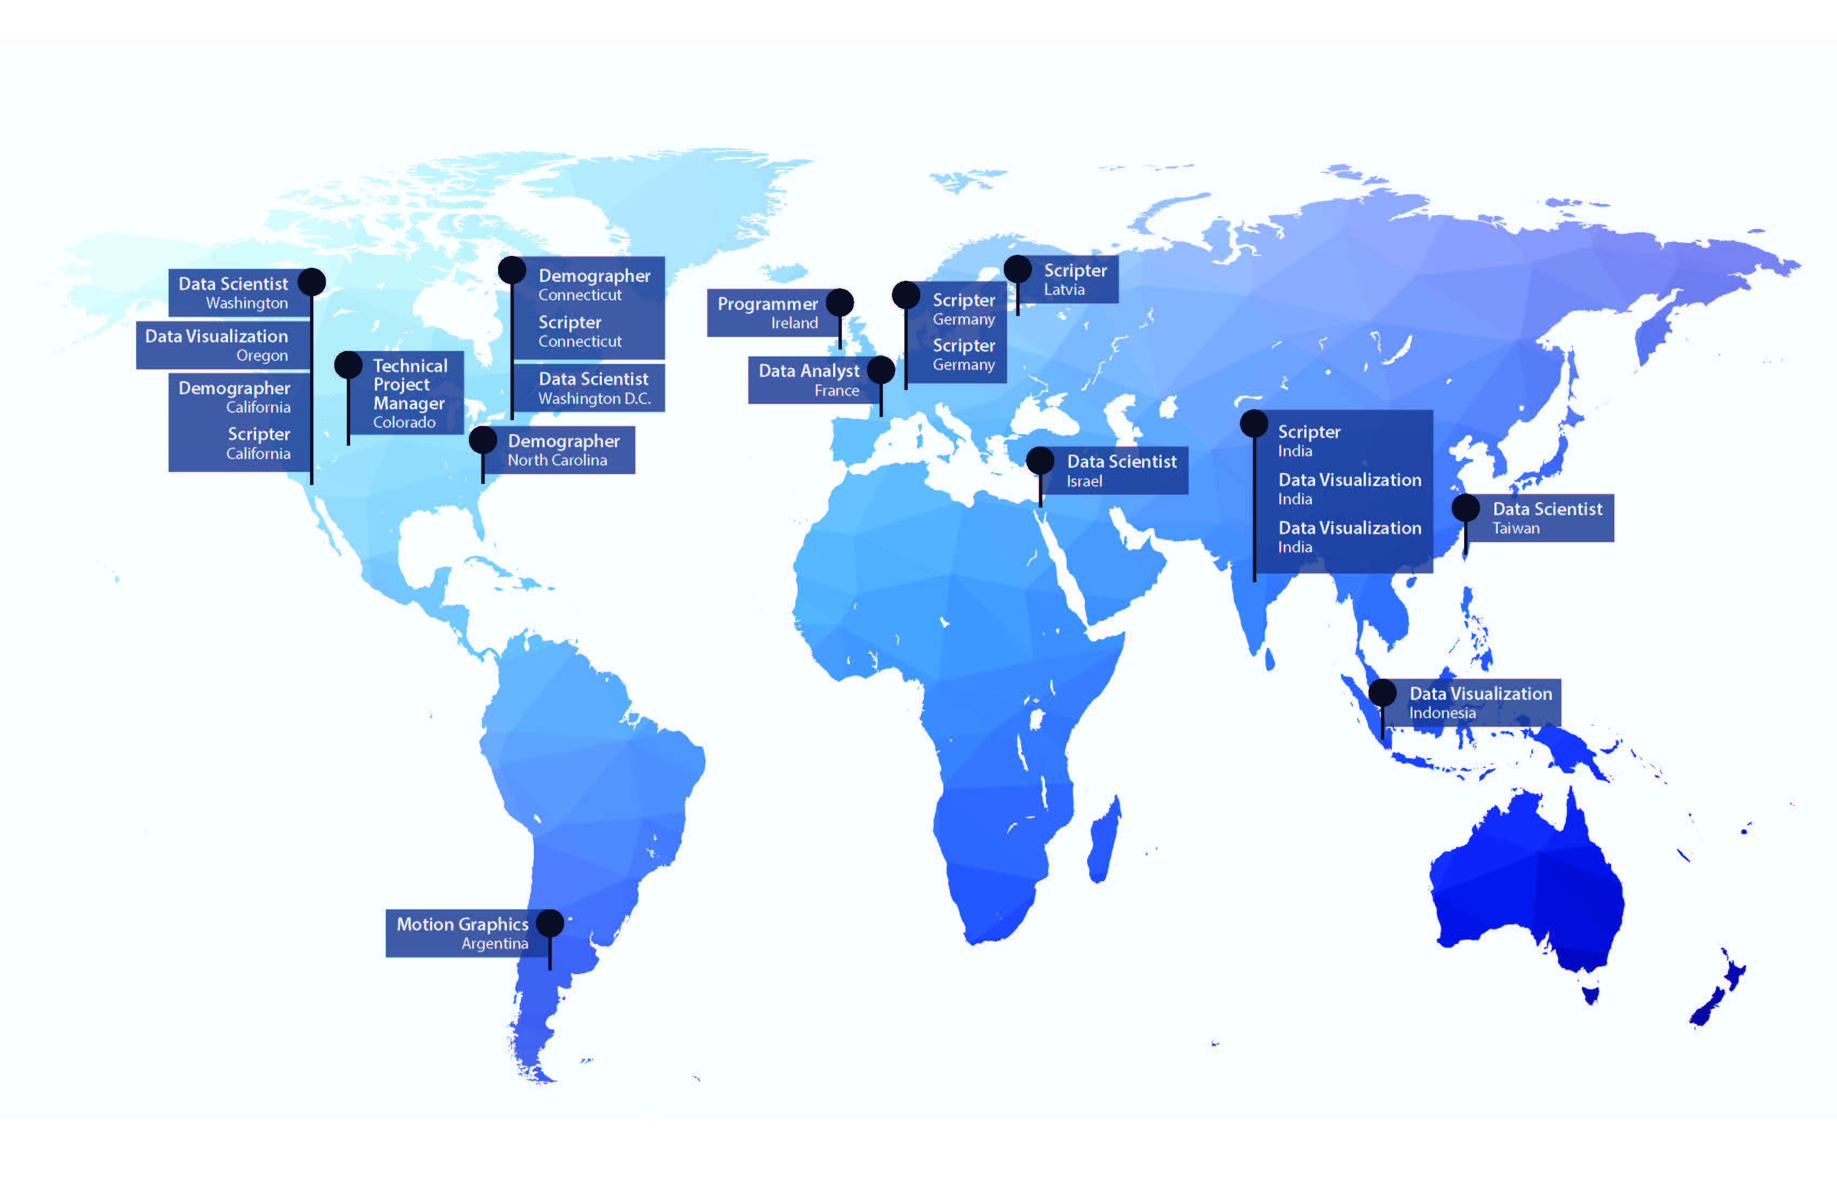
Growing, Skilled, and Diverse Data Team
20 Foreign languages
40 Programming languages

Slide 27


Comprehensive Data Sets
National
State
Hyper-local
  County
  Local
  Assessor
    Census
    Building
    GIS

Slide 28


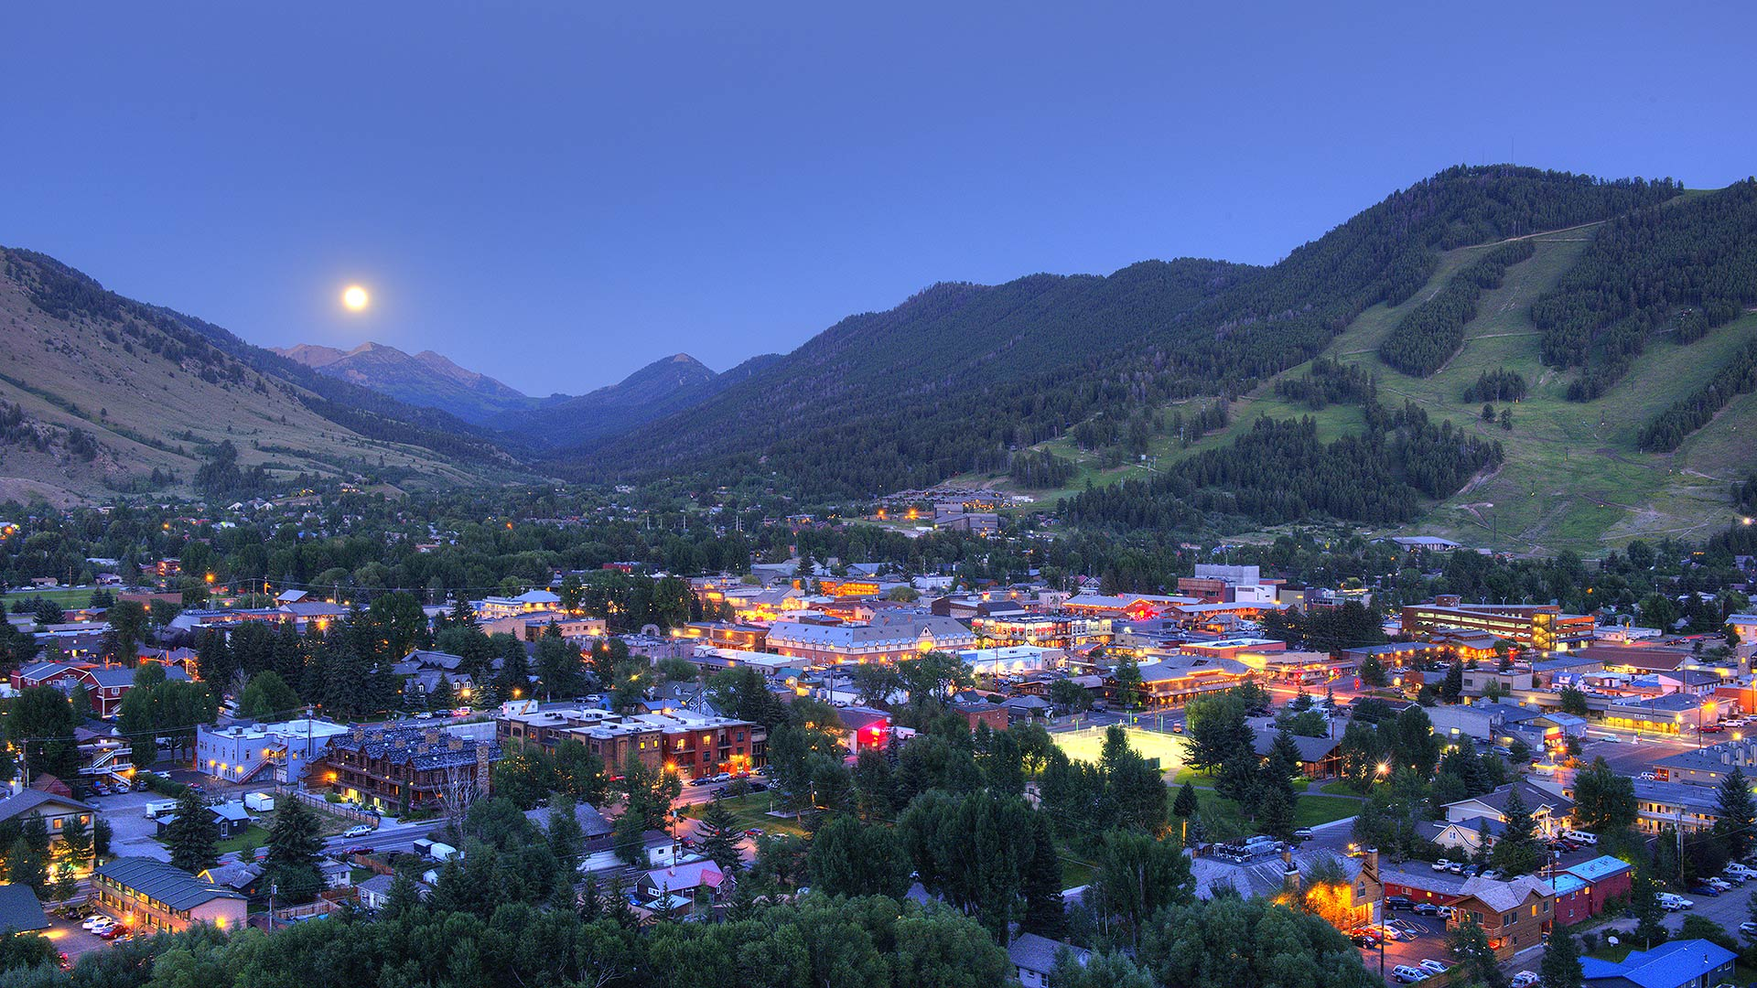
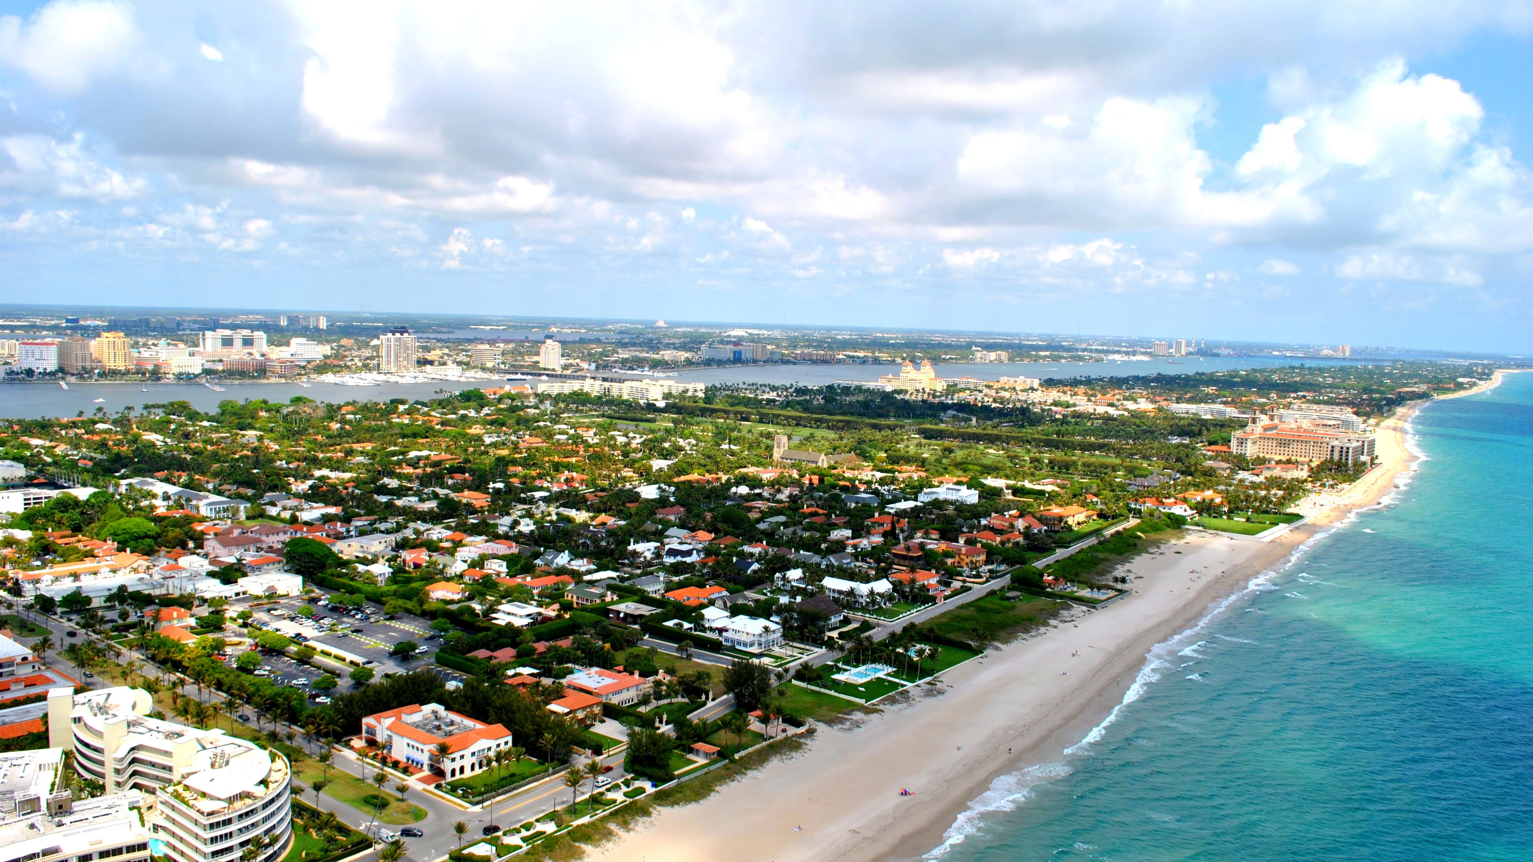

Slide 30
