Slide 1
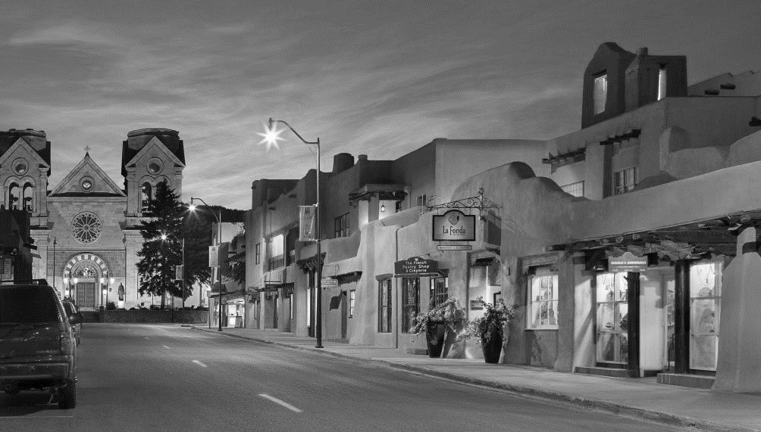

Notes:
Thank you all for coming. Thank Garrett Thornburg, Allan Oliver, Cyndi Conn and her colleagues at Creative Santa Fe for organizing this. That my colleagues Julia an dSerge wo I hope you’ll meet.
Looking across this room and learning from Allan and Cyndi the energy that this topic has generated is really gratifying.

Slide 2
If you want to be an optimist about America, stand on your head.
The country looks so good from the bottom up.
Thomas Friedman

Slide 3
Some communities are forming what I call “complex adaptive coalitions” and are thriving from the bottom up.
And others that can’t build such adaptive coalitions are rapidly deteriorating.
Thomas Friedman

Slide 4

Help leaders build
smarter & stronger
communities

Slide 5
The Problem
Businesses have data analytics
Communities don’t (with consistency)
It’s a massive problem

Slide 6
Business Leaders Say
80% have analytics
      Decision making - quality & speed
      Planning & forecasting
80% of executives believe the ‘have nots’ will be going out of business
Is it Much Different for Community Institutions?

Slide 7


It’s Not OK that Nike has Analytics
But Communities We Love Don’t

Slide 8




Four Risks
Wasted Money
Wasted Time
Damaged Reputations
Bad Outcomes

Slide 9



Slide 10



Slide 11
Priorities of Leaders
Pressing questions
Reliable answers
Compelling storytelling
Continuity of analytics

Slide 12
ReMain’s Three Pressing Questions
How many people are here?
What are their demographics?
Can qualitative research help?
Can this effort persist?

Slide 13
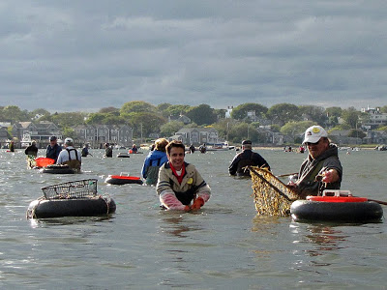

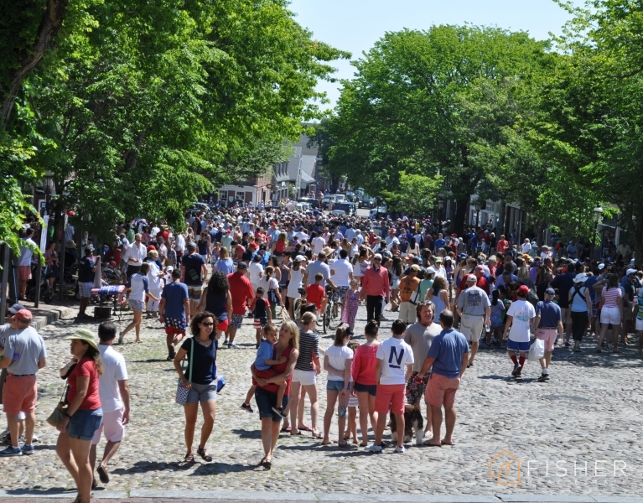
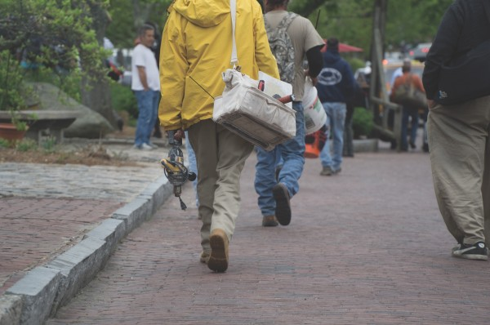

Understanding Effective Population
Permanent Residents
Seasonal Residents
Visitors
Commuters
Seasonal Workers

Slide 14
Nantucket’s 2017 Effective Population

Slide 15


Slide 16
Minute By Minute
Population Change

Slide 17
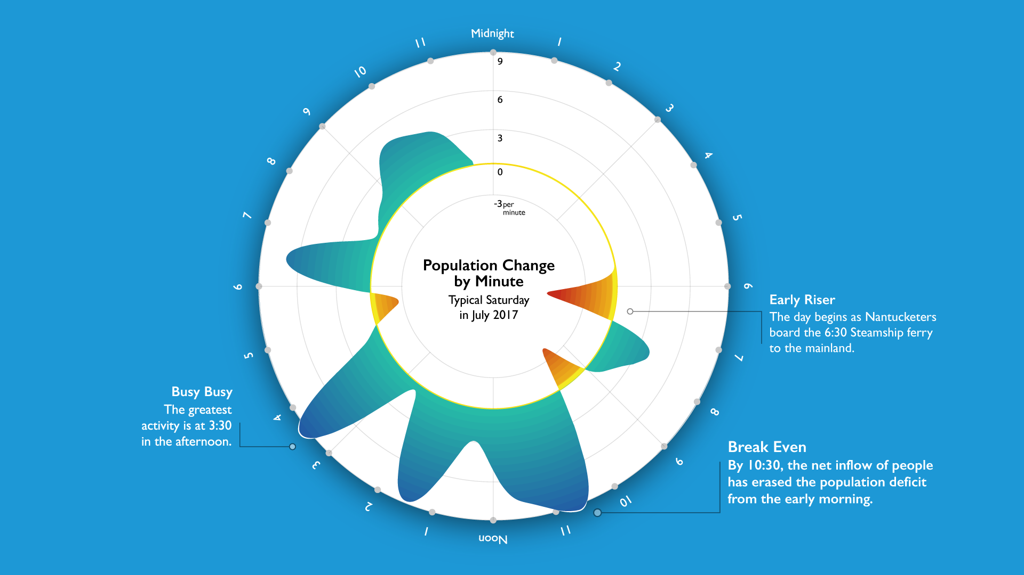

Slide 18
A Saturday in July

Slide 19

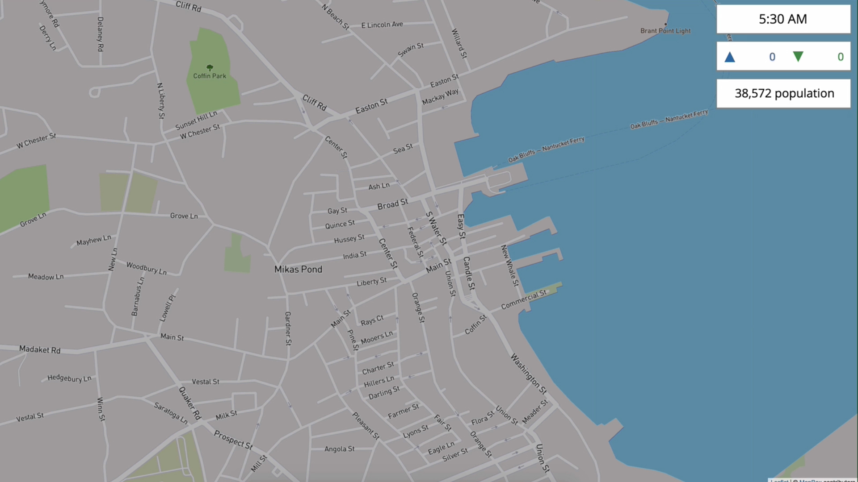

Slide 20
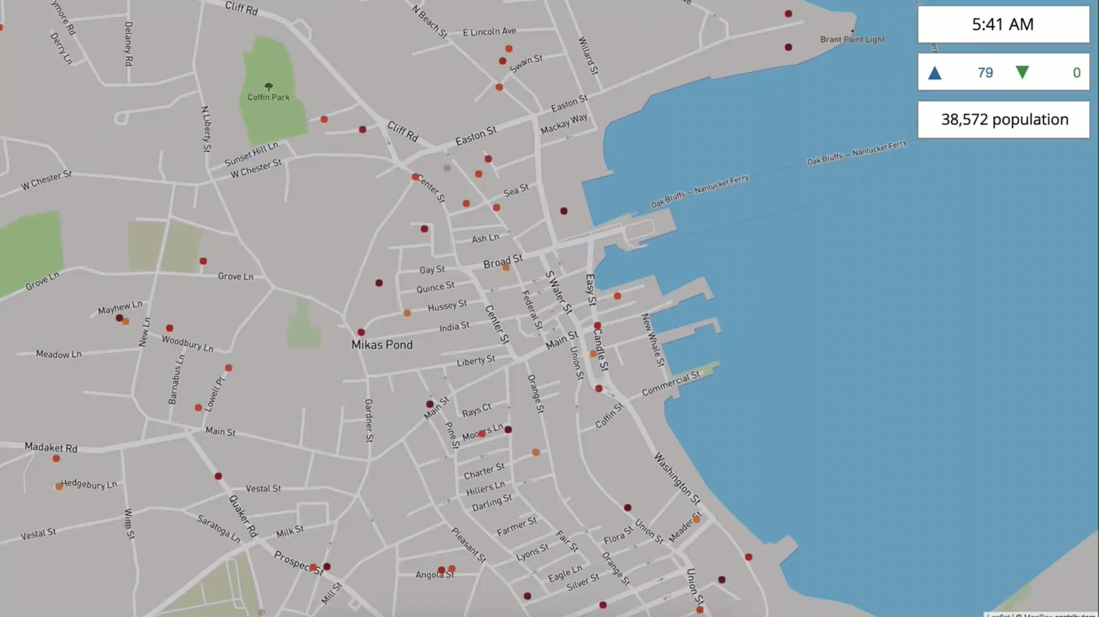

Slide 21
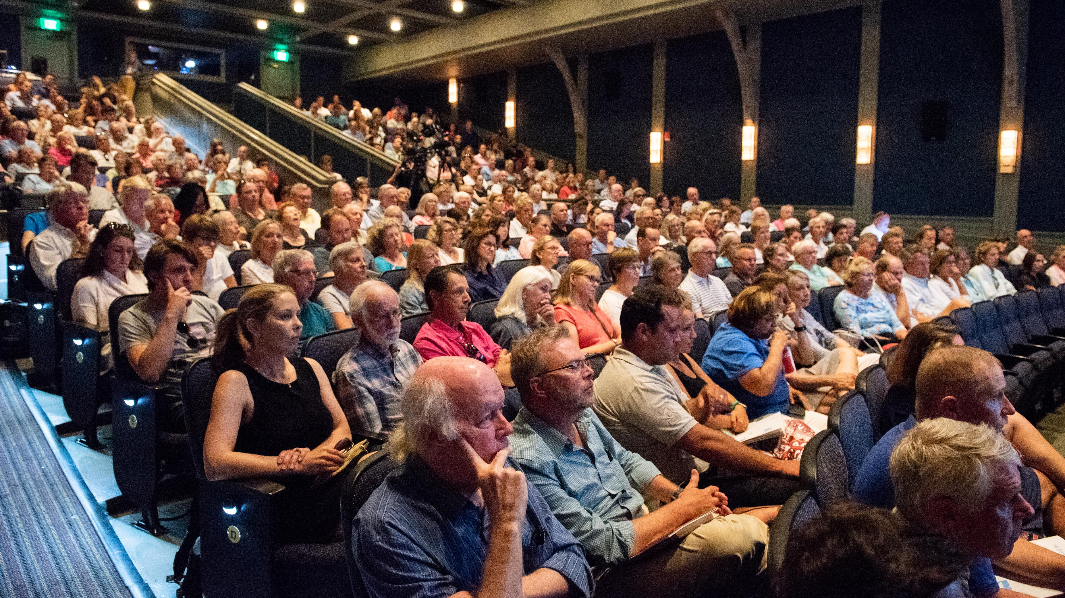

Slide 22



Critically Knowable
Permanent Population
NDP
17k
US Census
11k
Local Estimates
15k – 25k
Seasonal Population
NA
70k – 80k
49k
Too Big
Just Right
Too Small

Slide 23
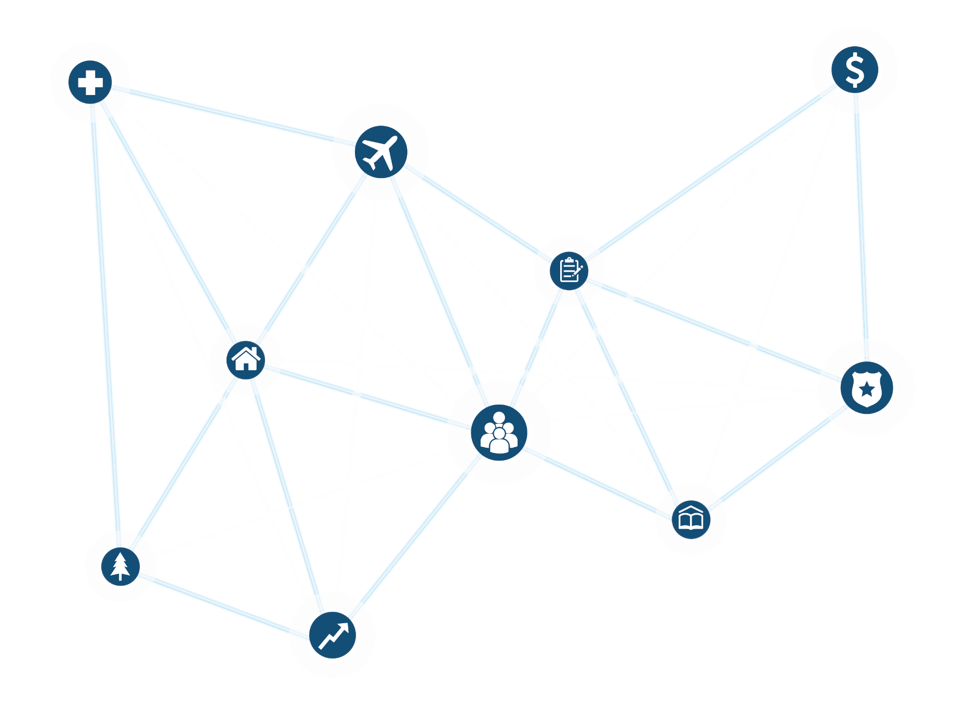
Wide Impact on Policy Areas

Slide 24
Wide Impact
Municipal Finance

Slide 25
Wide Impact
Business

Slide 26
Wide Impact
Climate Change

Slide 27
Wide Impact
Healthcare

Slide 29
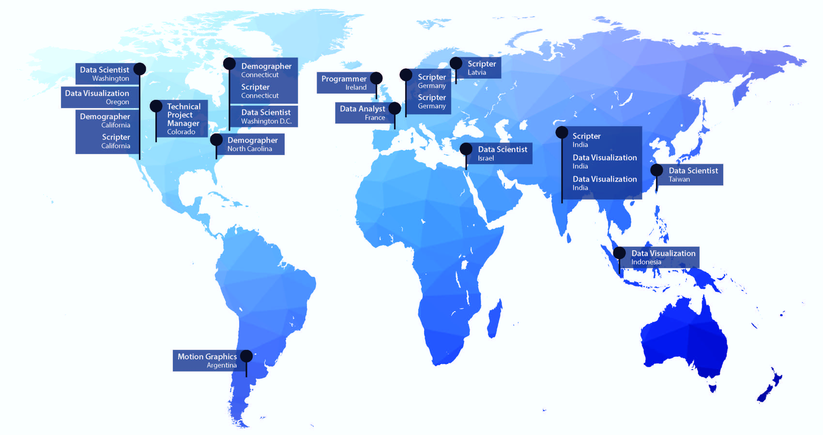
The Data Team
20 Foreign Languages 40 Programming Languages

Slide 30
The Process
Identify a Pressing Question
Develop a Methodology
Aggregate Data
Develop Insights
Create Compelling Visualizations
Persist

Slide 31
Current Pressing Questions
Cost of Living
Tourism
2020 Census
Healthcare
Affordable Housing
Government Finance
Traffic
Education
Behavioral Health
Qualitative Survey Panel

Slide 32




Anchor Institutions Leverage Analytics
Nonprofits
Businesses
Government
Econ Dev Boards

Slide 33
Simple Math
4 + 4 + 4 + 4 = 16
16^{X}

Slide 34

Understanding Workers’
Home Location

Slide 35
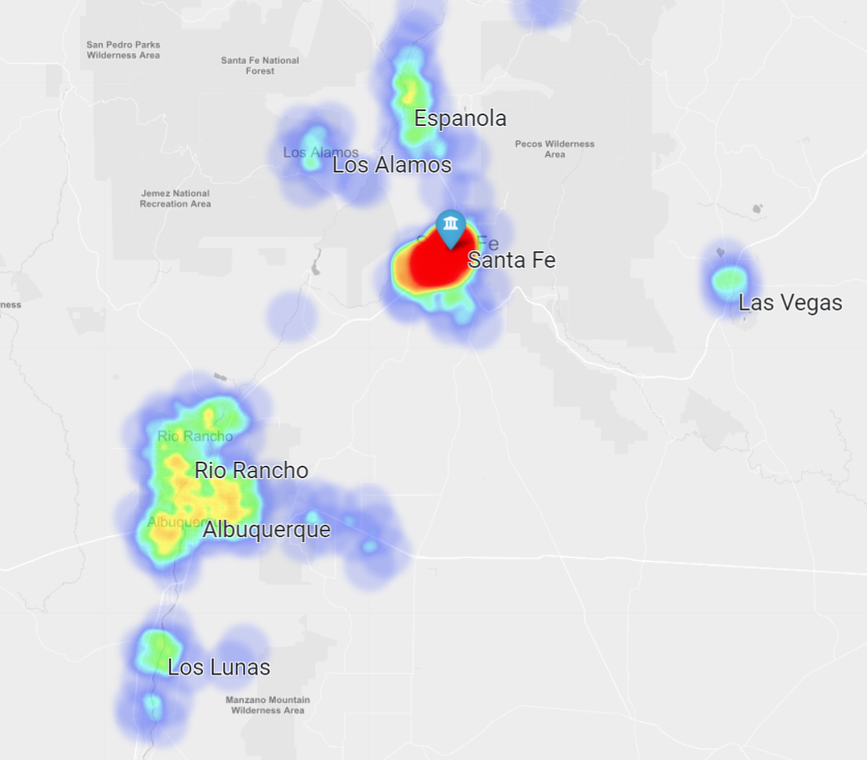
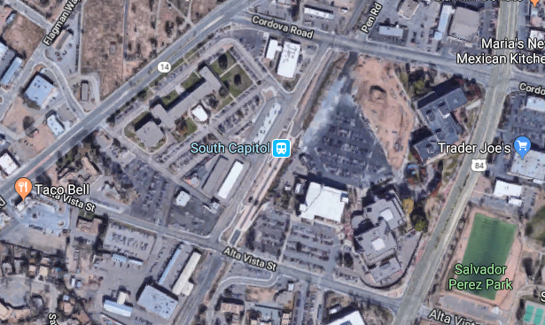
Worker Housing
We can geofence New Mexico government buildings (General Services, DOT, Department of Health) and determine the home locations of workers who frequent these offices.
Although most workers live in and around Santa Fe, some commute from other nearby communities.
Notes:
Draw boxes around the complexes. Summary percents for each city/town

Slide 36
Worker Housing
Place | Median Income | Median Housing Value | Median Age | Percent Worker Trips
Albuquerque | $55,304 | $210,575 | 40 | 8.3%
Los Alamos | $112,475 | $281,505 | 44 | 1.7%
Española | $34,763 | $155,150 | 40 | 2.8%
Las Vegas | $30,211 | $121,707 | 40 | 0.8%
Los Lunas | $43,631 | $127,131 | 39 | 8.3%
Santa Fe | $57,879 | $307,657 | 45 | 50.0%
Sources: StreetLight Data, US Census Bureau ACS 2017
These demographic statistics represent only the neighborhoods corresponding to workers. The workers who live in Santa Fe live in neighborhoods with the highest housing values and the oldest population.
Notes:
Add a column for percent, or percents on the map. Add sources to the slides.

Slide 37
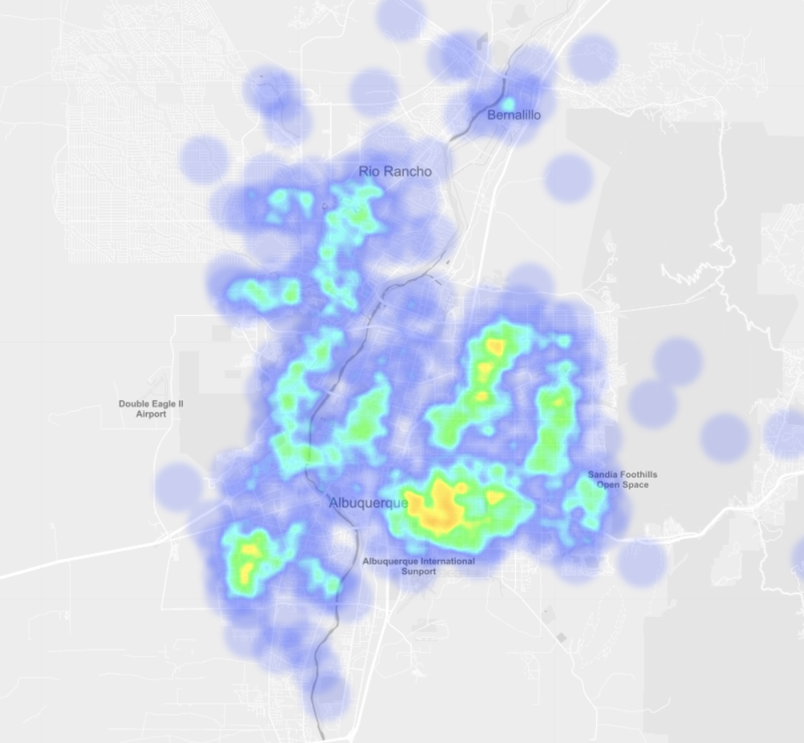
Worker Housing
Place | Median Income | Median Housing Value | Median Age
Southeast Albuquerque | $43,941 | $201,806 | 39
Remainder of Albuquerque | $58,499 | $212,848 | 40
Santa Fe | $57,879 | $307,657 | 45
Sources: StreetLight Data, US Census Bureau ACS 2017
The highest concentration of workers live in the southeast part of Albuquerque. These worker origin neighborhoods have lower housing values, lower median income and a younger population.
The median income of New Mexico is $46,718 according to the most recent Census estimate, making southeast Albuquerque lower than the state average.
Notes:
Add Santa Fe to this table as a reference point.

Slide 38
Understanding
Tourists Origins
July 2018

Slide 39
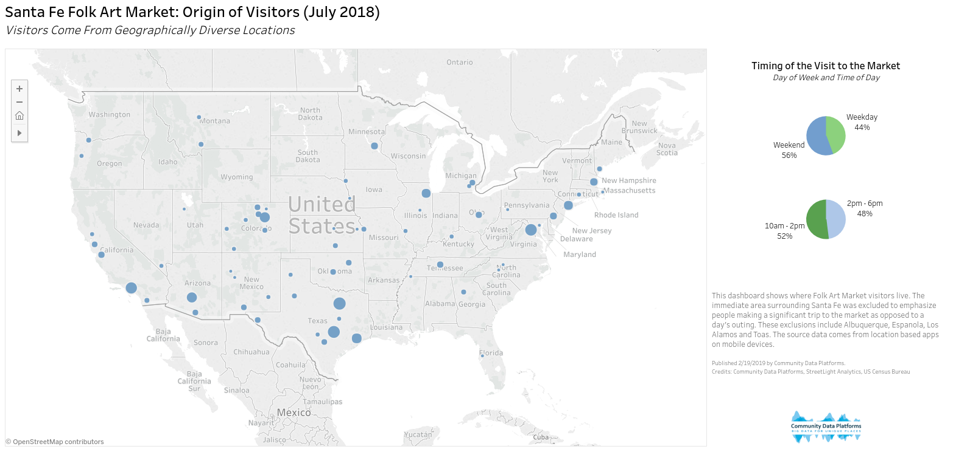
Tourism

Slide 40
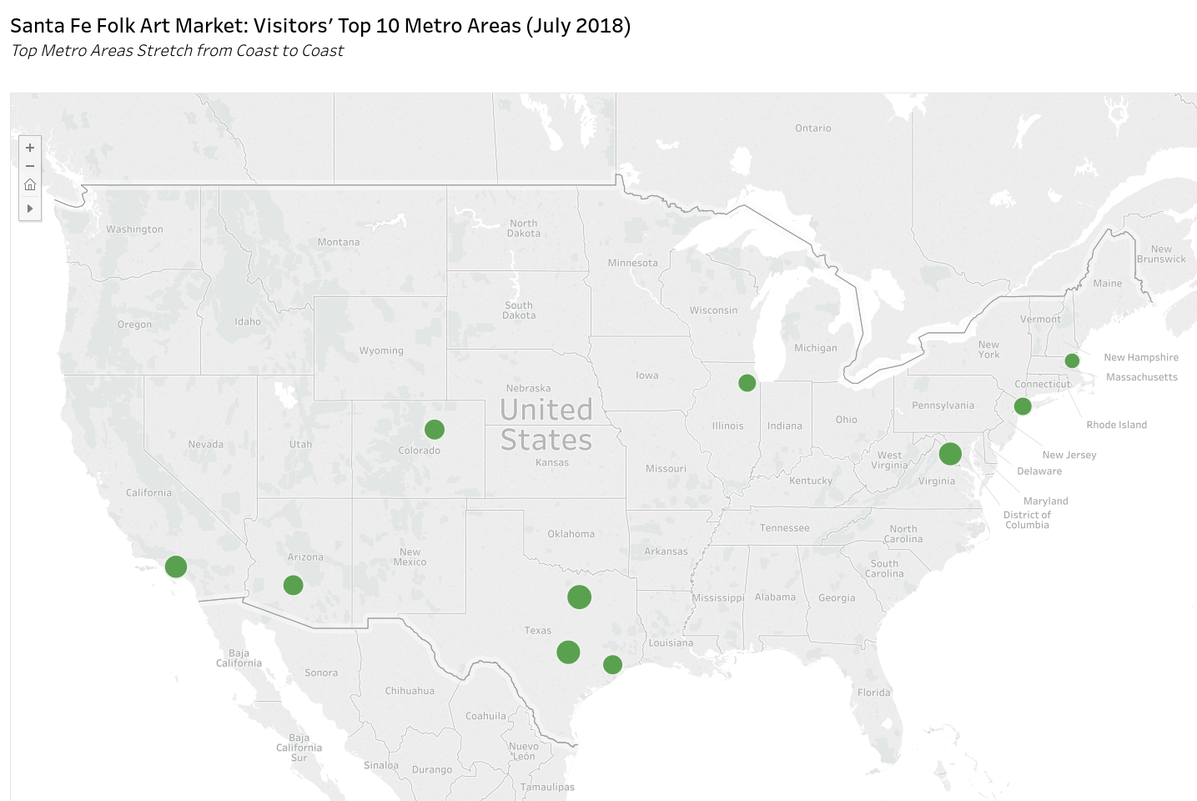
Tourism
Top 10 Visitor Metro Areas
Dallas, TX | 6.9%
Austin, TX | 6.5%
Washington, DC | 6.2%
Los Angeles, CA | 5.8%
Denver, CO | 4.7%
Phoenix, AZ | 4.7%
Houston, TX | 4.3%
Chicago, IL | 3.6%
New York, NY | 3.6%
Boston, MA | 2.5%
This dashboard shows the top 10 metro areas where Folk Art Market visitors live. The immediate area surrounding Santa Fe was excluded to emphasize people making a significant trip to the market as opposed to a day’s outing. These exclusions include Albuquerque, Espanola, Los Alamos and Taos. The source data comes from location based apps on mobile devices.
Published 2/19/2019 by Community Data Platforms
Sources: Community Data Platforms, StreetLight Analytics, US Census Bureau

Slide 41
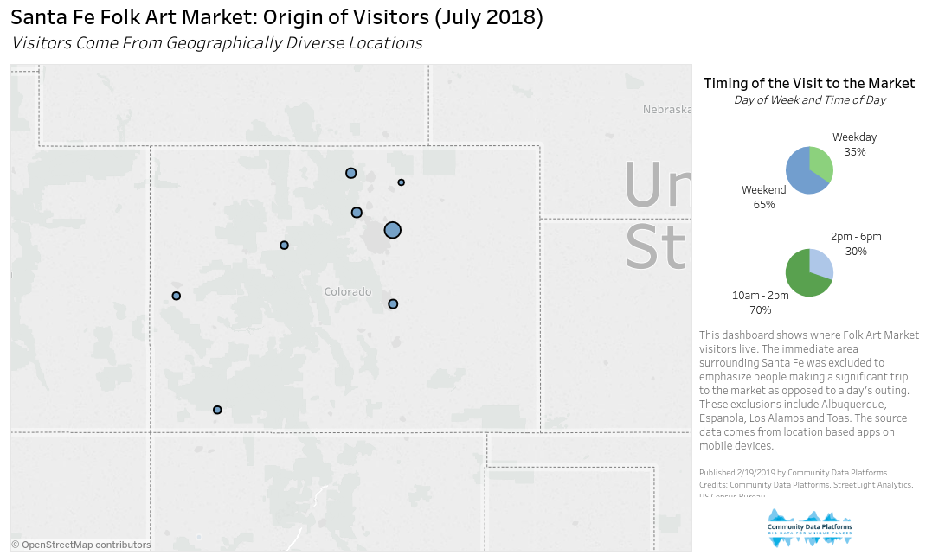
Tourism
Coloradans show up early, with 70% visiting the Market before 2pm.
They are more likely than average to make it a weekend trip.

Slide 42
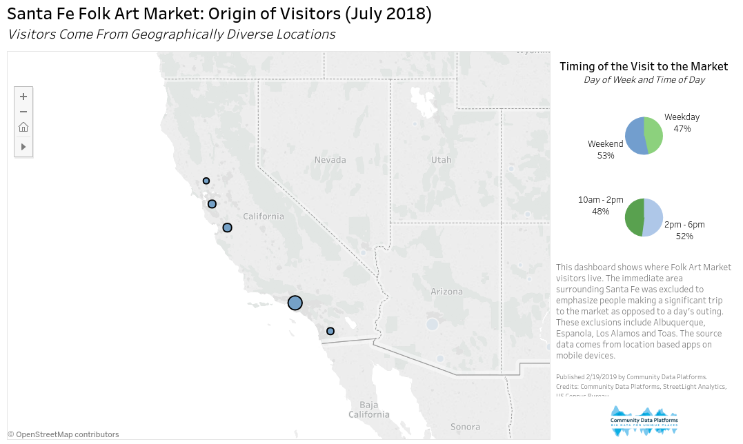
Tourism
On average, Californians like to show up later in the day, with the majority browsing the Market after 2pm.
Visitors from California are also much more likely to visit on a weekday.

Slide 43
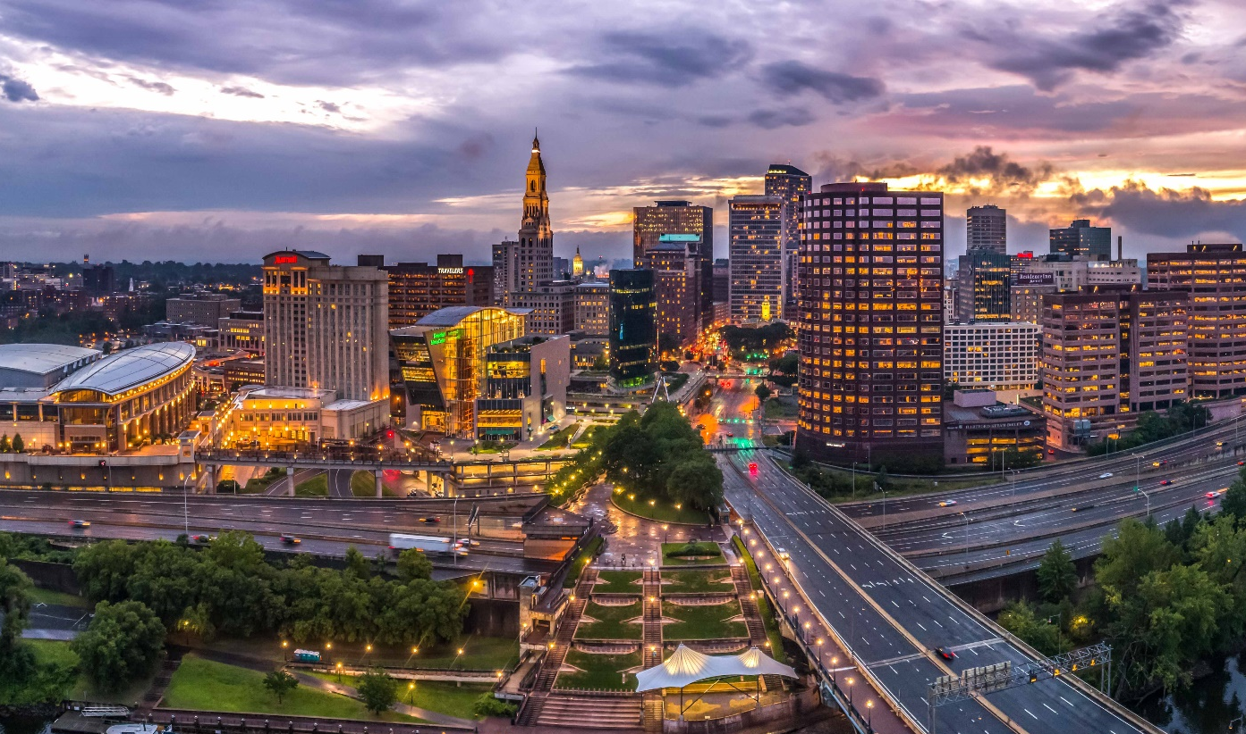
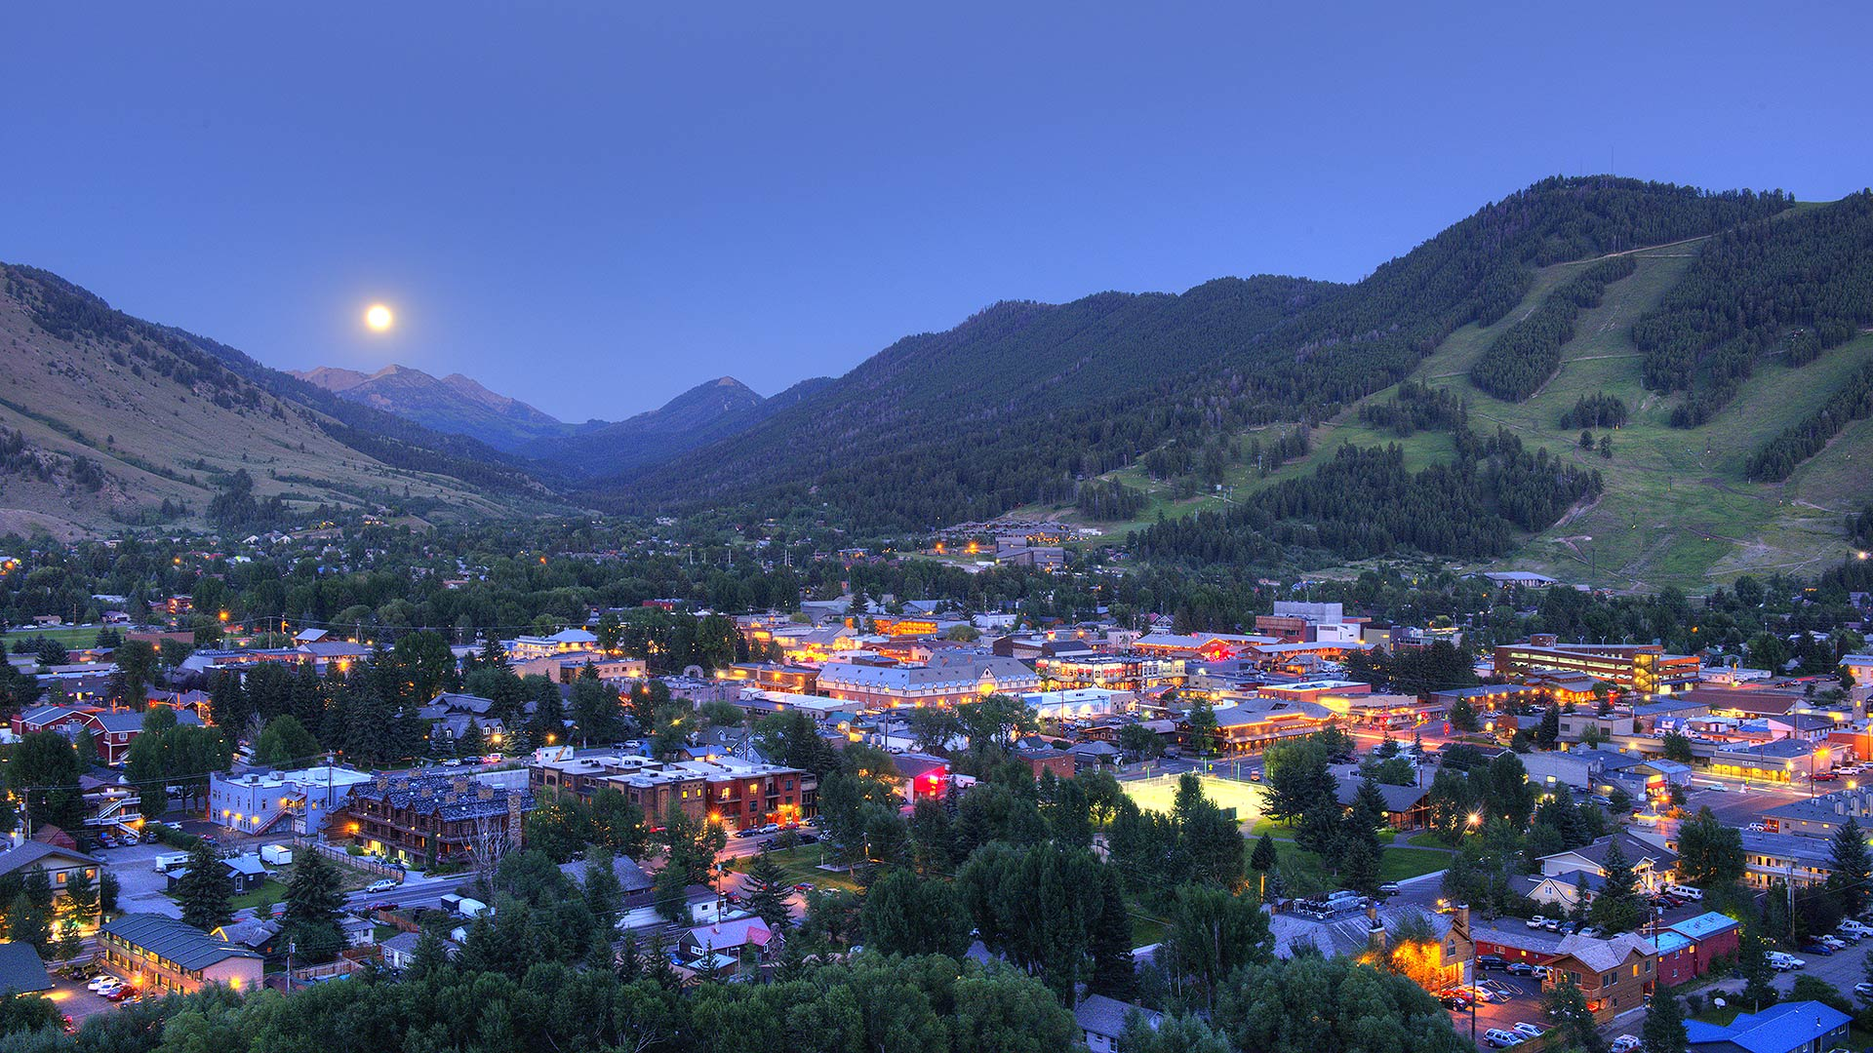
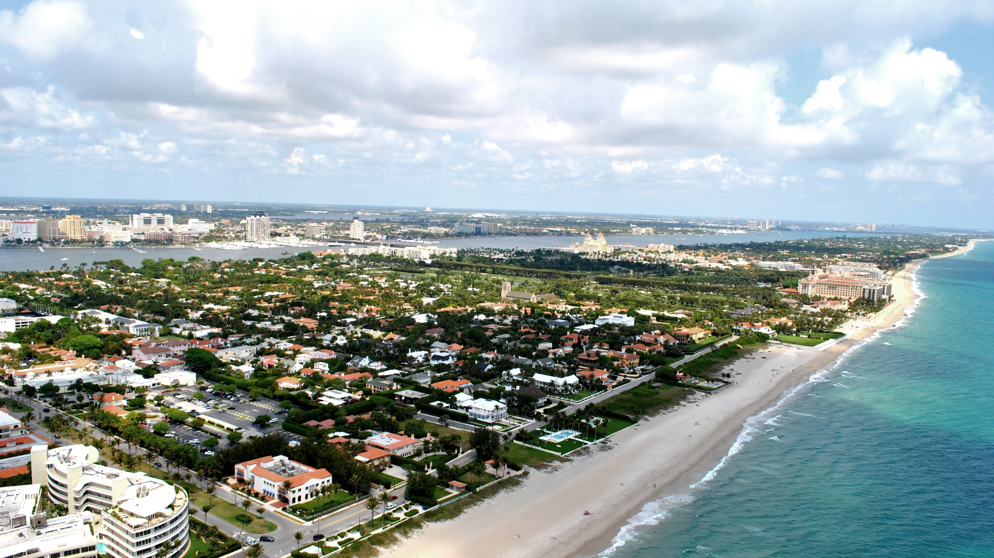
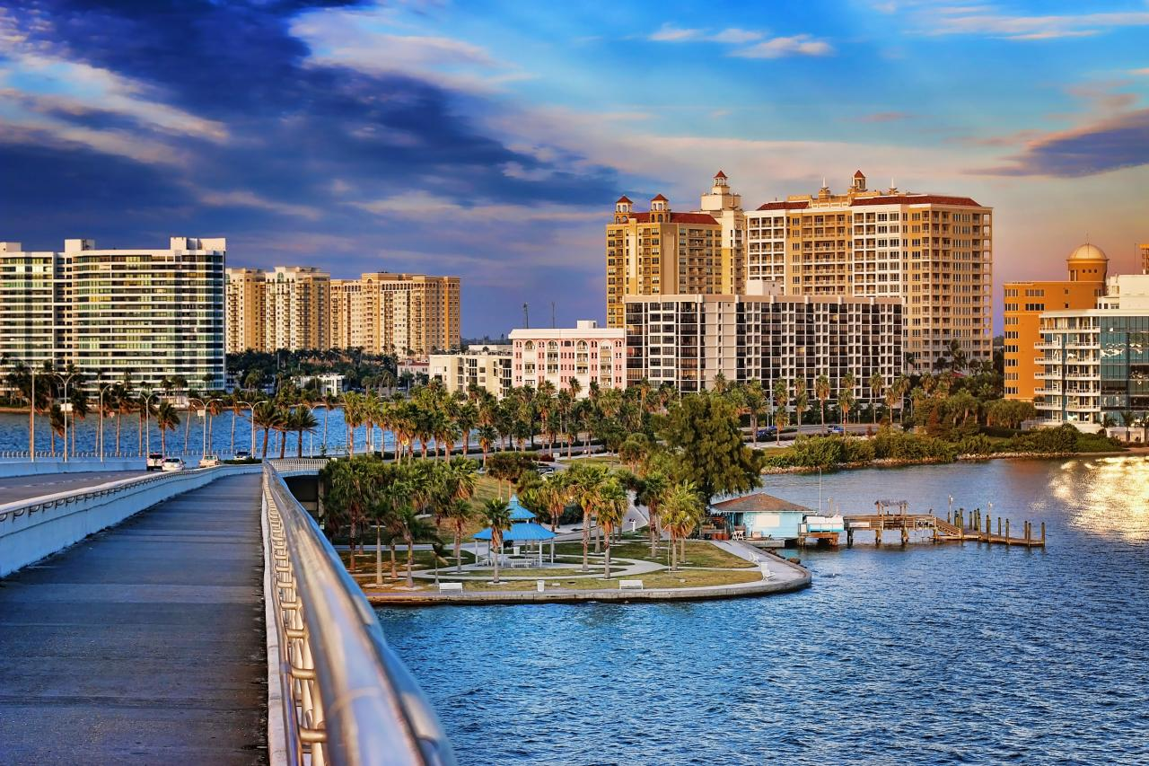


Slide 45
